Slide 1

DriverPass System Analysis
Matthew Biletnikoff
Notes:
[No speaker notes required for this slide.]

Slide 2

System Requirements
Functional Requirements
The system must allow students to schedule
driving lessons and exams online.
The system must provide instructors and administrators
with the ability to update schedules and track student
progress.
Nonfunctional Requirements
The system must ensure high availability with minimal
downtime to support users at all times.
The system must provide a user-friendly interface that is
easy for students, instructors, and administrators to
navigate.
Notes:
For the DriverPass system, functional requirements are the actions the system must perform. One of the most important functions is letting students schedule lessons and exams online. Another is enabling instructors and administrators to manage schedules and track student performance. Nonfunctional requirements are more about system qualities. For example, the system must be available most of the time so users do not face interruptions, and it must provide a simple, intuitive interface so that users can easily interact with it without needing extra training.

Slide 3
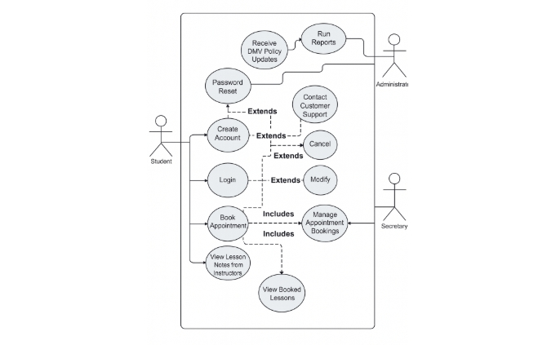
Use Case Diagram
[Insert your use case diagram here.]
Notes:
This diagram shows the main interactions between different types of users and the DriverPass system. Students are able to create accounts, log in, book appointments, and view lessons or notes from their instructors. They can also reset passwords and contact customer support if needed. The secretary helps manage appointment bookings, while the administrator oversees higher-level tasks like running reports and receiving DMV policy updates. Each use case reflects actions the system must support to meet the needs of students, administrators, and secretaries, making sure everyone has access to the functions most relevant to their role.

Slide 4
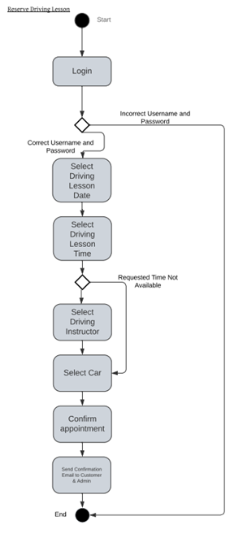
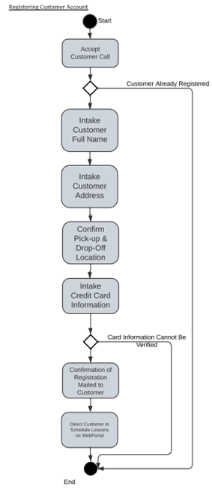
Activity Diagram
Notes:
(Reserve Driving Lesson) This activity diagram describes the process a student follows when reserving a driving lesson. The process begins with the student logging in. If the login is unsuccessful, the system prompts them to re-enter their credentials. Once logged in, the student selects a date and time for the lesson. If the time is unavailable, they must choose another option. They then select a driving instructor, choose a car, and confirm the appointment. At the end of the process, the system sends an email confirmation to both the student and the administrator. This workflow ensures that all details are properly recorded and communicated.
(Registering Customer Account) This diagram outlines the steps required to register a new customer account. The process begins with accepting a customer call. If the customer is already registered, the process ends there. Otherwise, the system collects the customer’s name, address, pickup and drop-off locations, and credit card information. If the payment information cannot be verified, the customer must try again. Once registration is successful, a confirmation is mailed to the customer, and they are directed to the web portal to schedule lessons. This ensures every customer is validated, set up correctly in the system, and ready to use its services.

Slide 5
Security
Secure login credentials for all users
Encrypted storage of sensitive data
Role-based access controls for students,
instructors, and administrators
Regular system updates and monitoring for vulnerabilities
Notes:
Security is a key priority for DriverPass. The system will require secure logins for all users to protect against unauthorized access. Sensitive data such as personal details and scheduling information will be encrypted to protect privacy. We will also implement role-based access controls, meaning each type of user — students, instructors, and administrators — will only see what they are allowed to. Finally, the system will be updated and monitored regularly to protect against potential security threats.

Slide 6
System Limitations
Internet access is required to use the system
System performance may be slower with large numbers
of users during peak hours
Dependence on accurate data entry from instructors and
administrators
Limited offline functionality
Notes:
Like any system, DriverPass has some limitations. Since it is an online service, users must have internet access to use it. During busy times, such as right before exams, the system might be slower if many users are logged in at once. The system also depends on instructors and administrators entering accurate data, since incorrect information could cause scheduling issues. Lastly, offline functionality is limited, which means users will need to connect online for most tasks.

